Slide 1

Query the database
Week 9

Slide 2
OBJECTIVES:
CREATE
CREATE A DATABASE CONNECTION
PERFORM
PERFORM QUERY
Use
Use returned information
Release
Release data
Close
Close connection

Slide 3
commands
mysqli_query($connection,$query)-→second param is actually querys
mysqli_free_result($result_set)

Slide 4
The mysqli_connect() function in PHP is used to connect you to the database. In the previous version of the connection mysql_connect() was used for connection and then there comes mysqli_connect() where i means improved version of connection and is more secure than mysql_connect()
The mysqli_free_result() function frees the memory associated with the result.
PHP MySQLi Functions :
https://www.w3schools.com/php/php_ref_mysqli.asp
PHP Network Functions :
https://www.w3schools.com/php/php_ref_network.asp

Slide 5
Create Database

Slide 6
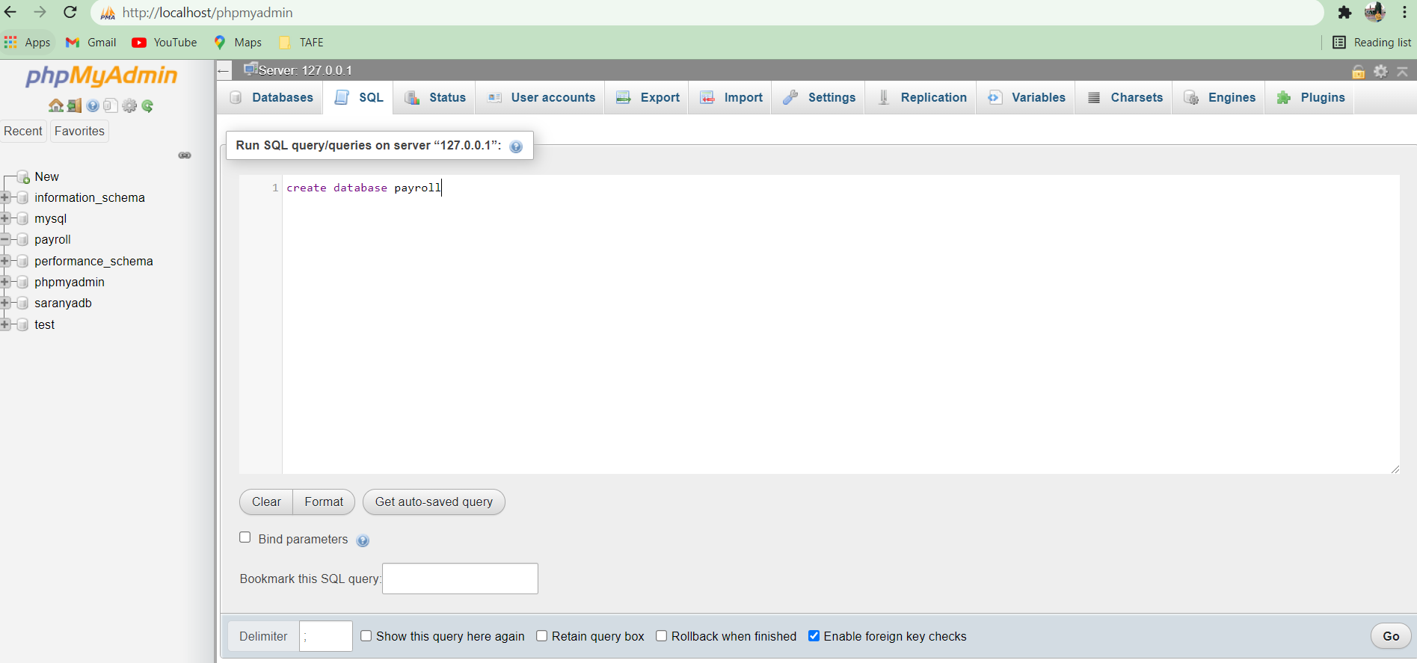
Create database named payroll
Run the XAMPP and run the below query in browser to create Database

Slide 7
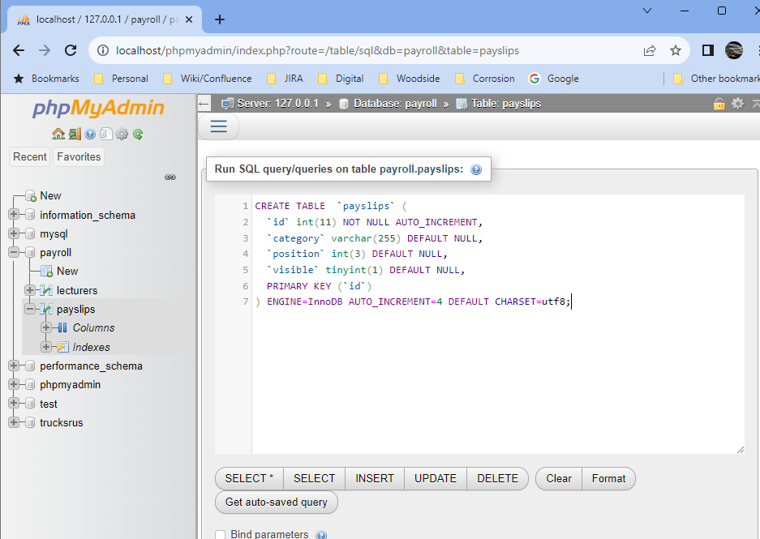
Create table named payslips

Slide 8
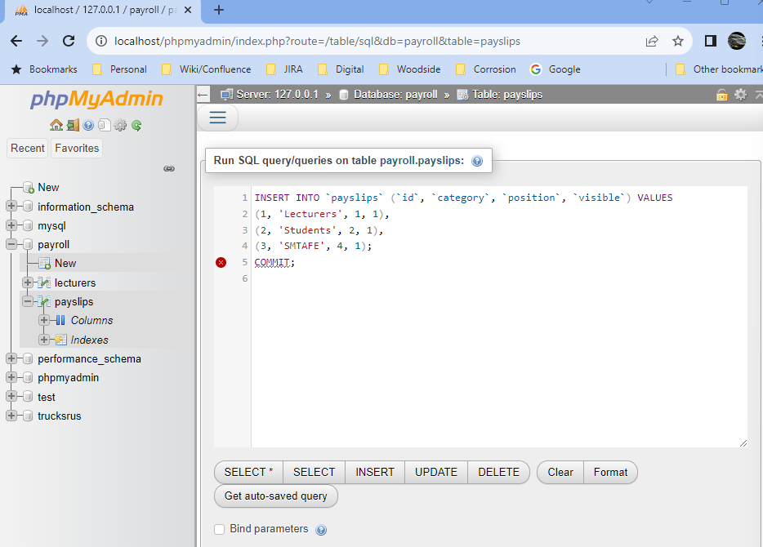
Insert values into payslips

Slide 9
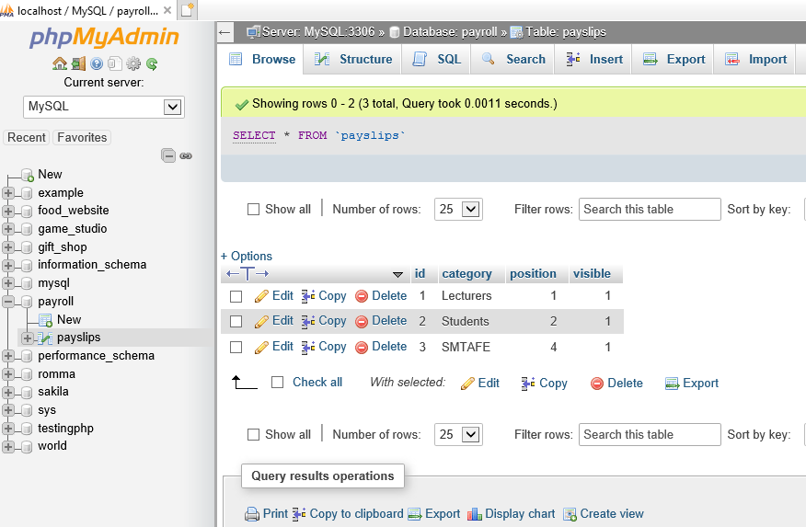
Check do we have values

Slide 10
Now, the plan is to remove our array(Hardcoded) and use DB to get the values
WE WILL REMOVE OUR ARRAY AND REPLACE IT WITH A FUNCTION

Slide 11
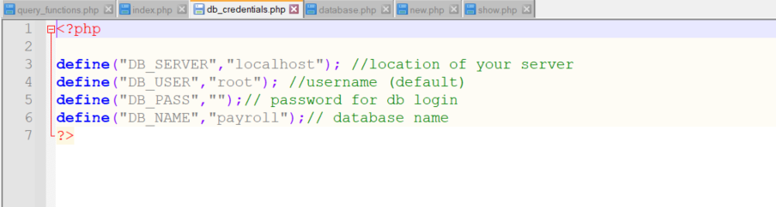

Slide 12
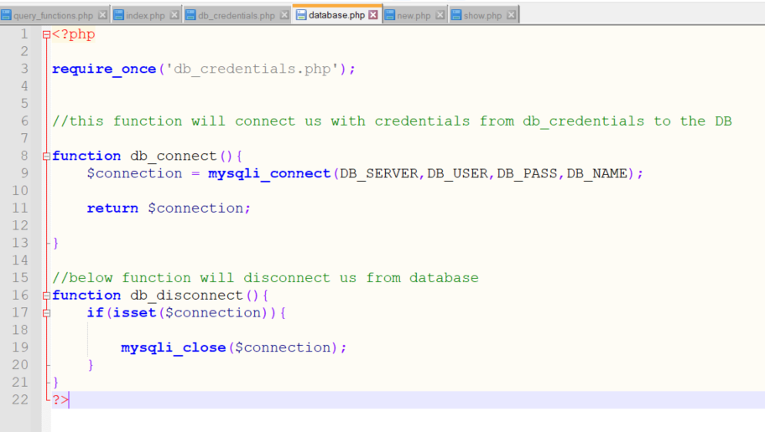

Slide 13
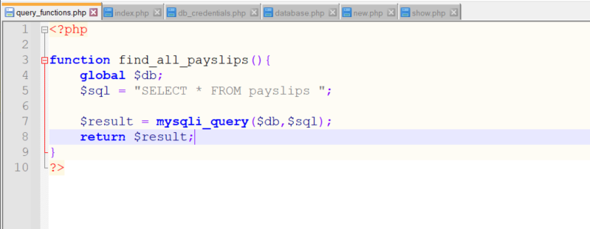

Slide 14
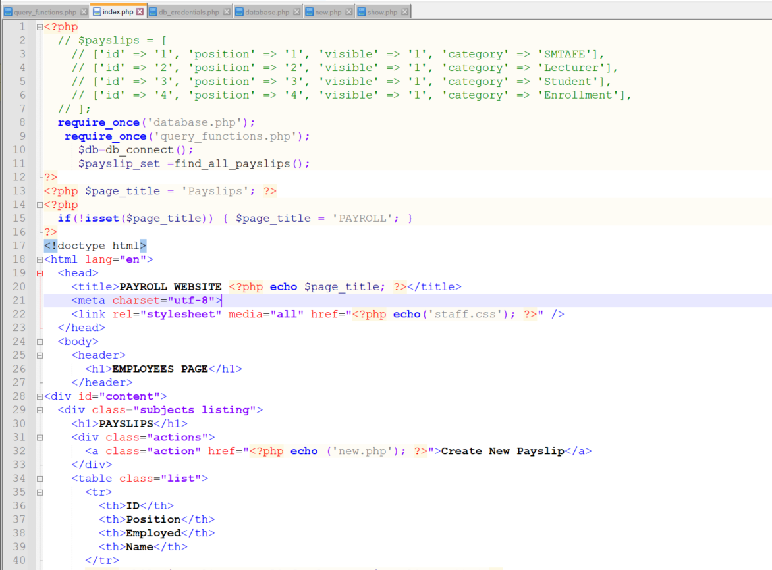

Slide 15
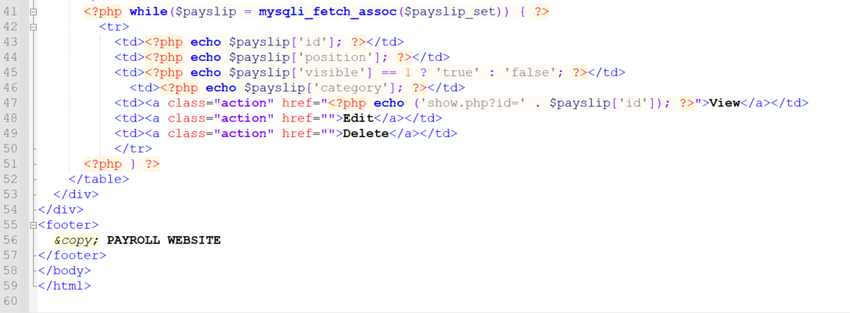

Slide 16
